Slide 1
Chapter 5
Civil Rights
American Democracy Now, 7th edition
Brigid Callahan Harrison
Jean Wahl Harris
Michelle D. Deardorff
Copyright 2022 © McGraw Hill LLC. All rights reserved. No reproduction or distribution without the prior written consent of McGraw Hill LLC.

Slide 2
The Meaning of Equality Under the Law 1
Civil rights: the rights and privileges guaranteed by the government under the equal protection and due process clauses of the Fifth and Fourteenth amendments; the idea that individuals are protected from discrimination based on inherent characteristics.
Also the privileges and immunities clause of the Fourteenth Amendment.
Some rights are extended only to citizens, i.e. the right to vote.
Inherent characteristics: individual characteristics that are part of a person’s nature, such as race, religion, national origin, and sex.

Slide 3
The Meaning of Equality Under the Law 2
Constitution imposes constraints (civil liberties) and responsibilities (civil rights) on governments.
Like civil liberties, civil rights are not absolute.
Today, the courts use three tests to determine when unequal treatment is legal.
Strict scrutiny, heightened scrutiny, and ordinary scrutiny.
Courts view race, ethnic origin, and religion to be suspect classifications.

Slide 4
Strict Scrutiny
Courts use the strict scrutiny test to hear a challenge to laws with suspect classifications.
Government must show that the differential treatment is necessary for it to achieve a compelling public interest for which it is responsible.

Slide 5
Heightened or Intermediate Scrutiny
Courts apply the heightened scrutiny test (also known as the intermediate scrutiny test) in sex-based discrimination cases.
Government must show that the sex-based differential treatment is substantially related to an important public interest for which the government is responsible.

Slide 6
Ordinary Scrutiny
Under the ordinary scrutiny test, courts require governments to show that the differential treatment is a rational means to achieve a legitimate public interest for which the government is responsible.
Example: legal age discrimination in the establishment of minimum ages for certain activities.

Slide 7
Fat Rights: Prohibiting Weight Discrimination at Work
A new arena of civil rights activism is developing to protect against weight discrimination in the workplace.
San Francisco and Washington, D.C. have passed antidiscrimination laws based on weight or appearance, and Michigan (2014) and Washington State (2019) have such laws on record.
Critics argue that weight is under the control of the individual and therefore falls into a different category than race or gender.

Slide 8
Slavery and Its Aftermath
When it was first written, the Constitution implicitly endorsed unequal and discriminatory treatment of African Americans.
Although the movement to abolish slavery was in its early stages in 1787 (the year the Constitution was completed), by the early to mid-1800s it had gained significant momentum in the North.
Largely because of the activism of various religious and humanitarian groups.

Slide 9
Slavery in the United States
Most African Americans today are descendants of those who were forcibly brought to the New World.
1619: the first Africans arrived as indentured servants, workers with a fixed term of service.
By the mid-1600s, slavery had begun to replace indentured servitude.

Slide 10
Opposition to Slavery
Missouri Compromise (1820) regulated slavery in newly acquired western territories.
Black and white dissenters to slavery were actively engaged in civil disobedience: nonviolent refusal to comply with laws or government policies that are morally objectionable.
Underground Railroad formed as a series of safe houses allowing slaves to flee to northern states and Canada.
Fugitive Slave Act of 1850 required the return of runaway slaves.

Slide 11
The Civil War Era 1
Uncle Tom’s Cabin (1852).
John Brown and Harper’s Ferry.
Dred Scott v. Sandford (1857): Supreme Court ruled the Missouri Compromise was unconstitutional, and that African Americans were not citizens with standing to sue.
Mobilized the abolitionist movement.
Viewing their way of life as under siege and alarmed by the election of Abraham Lincoln in 1860, southern states decided to secede; and a long and bloody war followed.

Slide 12
The Civil War Era 2
Emancipation Proclamation, issued by Lincoln in April 1862, abolished slavery in the states that had seceded.
Thirteenth Amendment (1865) ended slavery.
Fourteenth Amendment (1868) defined citizens as “all persons born or naturalized in the United States” and mandates the same privileges and immunities for all citizens and due process and equal protection for all.
Fifteenth Amendment (1870) decrees every man has the right to vote, regardless of color.

Slide 13
Reconstruction and the First Civil Rights Acts
Radical Republicans overruled moderates on how the South would be brought back into the political fold.
Reconstruction era: rebuilding of the institutions and infrastructure of the South, 1866 to 1877.
“Freemen,” or former slaves, made up a significant portion of the electorate and candidate pool.
Black Codes limited the rights of freemen.
Congress passed laws that sought to negate Black Codes.
Civil Rights Act of 1866.
Civil Rights Act of 1872.

Slide 14
Backlash: Jim Crow Laws 1
When Reconstruction ended, a rollback of gains for African Americans began.
Jim Crow laws required the strict separation of racial groups.
De jure segregation, legally mandated separation of the races, became the norm in much of the South.
De facto segregation (in fact if not in law) manifested in the North in housing, employment, and education.

Slide 15
Backlash: Jim Crow Laws 2
State and local governments in the South also found ways to prevent African Americans from exercising their right to vote.
White primary.
Literary test.
Poll tax.
Grandfather clause.
Jim Crow laws were enforced by both government agents and non-governmental groups, such as the Ku Klux Klan.

Slide 16
Governmental Acceptance of Discrimination
Civil Rights Cases of 1883:
Court ruled that Congress lacked the authority to prevent discrimination by private individuals and organizations
Declared the Civil Rights Act of 1875 unconstitutional.
Plessy v. Ferguson (1896):
Created the separate but equal doctrine declaring that separate but equal facilities do not violate the Fourteenth Amendment’s equal protection clause.

Slide 17
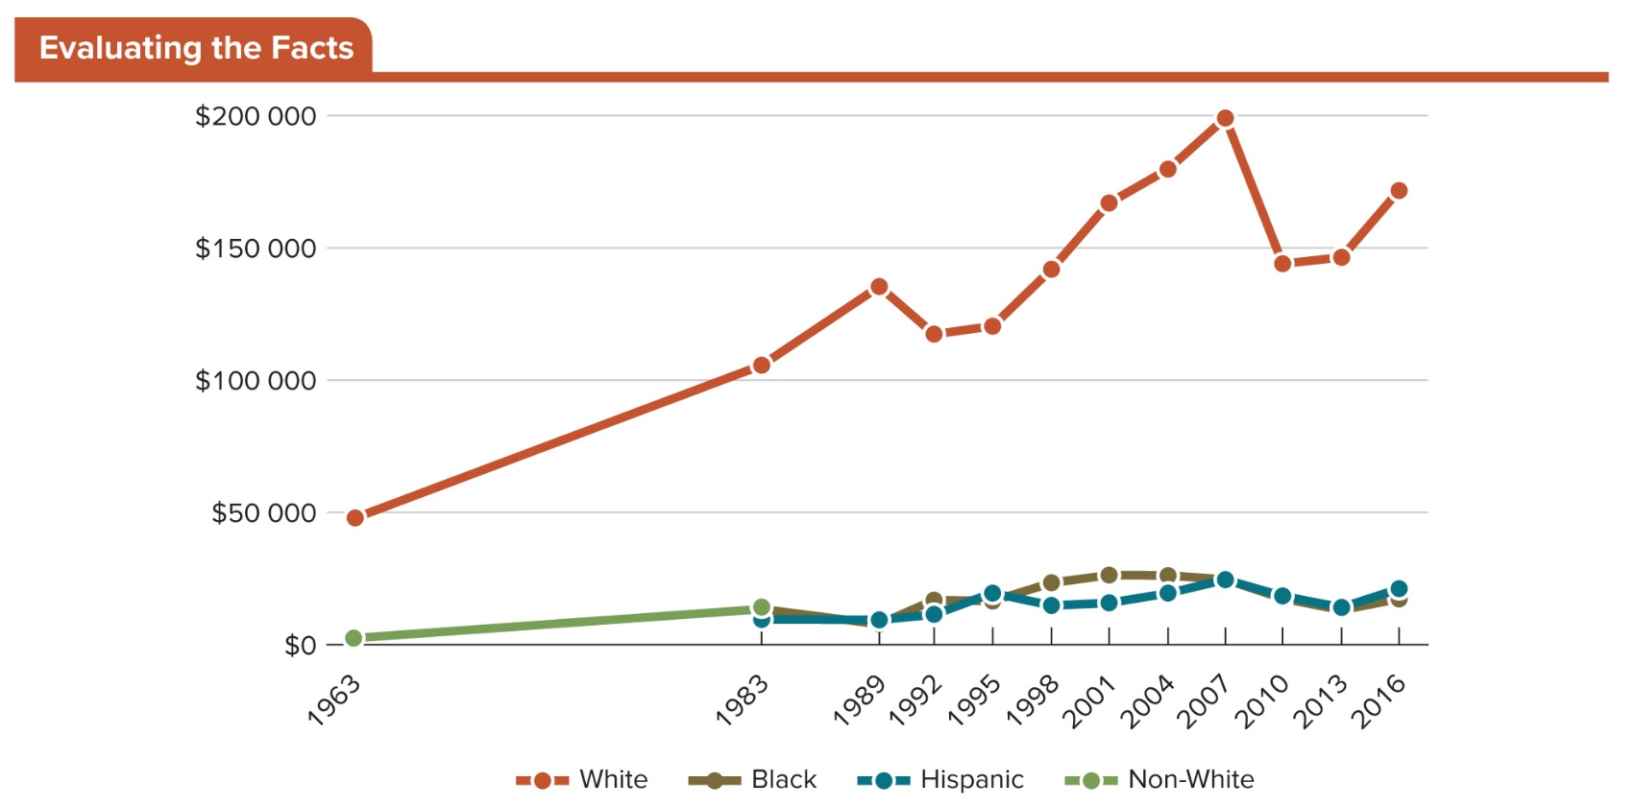
Figure 5.1 Median Family Wealth by Race/Ethnicity, 1963–2016
Access the text alternative for slide images.
SOURCE: Urban Institute calculations from Survey of Financial Characteristics of Consumers 1962 (December 31); Survey of Changes in Family Finances 1963; and Survey of Consumer Finances 1983–2016.

Slide 18
The Modern Civil Rights Movement
In the early decades of the 20th century, African Americans continued their struggle for equal protection of the laws.
Movement enjoyed some early successes.
Century was nearly half over before momentous victories finally began to change the status of African Americans in revolutionary ways.
Strong leadership, effective strategies, and new national media.

Slide 19
Fighting Back: Early Civil Rights Organizations
National Association for the Advancement of Colored People (NAACP) formed in 1909.
During the 1930s, lawsuits brought by the NAACP in several states ended discriminatory admissions practices in professional schools.
By the 1950s civil rights groups began to argue that segregation itself was unconstitutional.

Slide 20
The End of Separate But Equal
In 1954 the Supreme Court ruled in Brown v. Board of Education of Topeka that segregated schools violate the equal protection clause of the Fourteenth Amendment.

Slide 21
The Movement Gains National Visibility
Civil rights activists were buoyed by the Brown decision, but white supremacists were mobilized.
Murder of Emmett Till, 1955.
Rosa Parks and the Montgomery Bus Boycott, 1955.
Boycott was led by Martin Luther King, Jr.

Slide 22
Local Organizing and Civil Disobedience Strategies
Martin Luther King, Jr., advocated protesting government-sanctioned discrimination through civil disobedience and peaceful demonstrations, boycotts, and marches.
Other groups, including the SNCC and CORE, advocated voter registration drives and sit-ins.
Coalition of Federated Organizations’ 1964 Summer Project.
Televised violence against demonstrators generated positive opinions of the movement; but urban rioting eroded some of those feelings of goodwill.
April 4, 1968, Martin Luther King, Jr., was assassinated.

Slide 23
The Government’s Response to the Civil Rights Movement
As a result of the civil rights movement, Congress passed the 1965 Voting Rights Act, as well as the 1964 Civil Rights Act and the 1968 Civil Rights Act.

Slide 24
The Civil Rights Act of 1964
Includes numerous provisions that mandate equality:
Bans discrimination in public accommodations, including hotels, restaurants, and theaters.
Bars government agencies from discriminating and allows the federal government to sue to desegregate public schools.
Establishes the equality standard in employment opportunity (Title VII) and the legal foundation for a body of law that regulates fair employment practices.

Slide 25
Voting Rights Act of 1965
In the voter registration drive of 1964, two hundred and fifty thousand new voters registered.
Violent attacks on civil rights activists and citizens took place.
Congress passed the Voting Rights Act (VRA) of 1965.
Banned unfair voter registration practices.
Changes in some voting procedures required pre-approval from the Justice Department.
Shelby v. Alabama (2013) eliminated some protections provided by the VRA.

Slide 26
Impact of the Civil Rights Movement
Had a momentous impact on society by working for the laws and rulings that bar discrimination in employment, public accommodations, education, and housing.
Also had a profound impact on voting rights by establishing the principle that the laws governing voter registration and participation should ensure individuals are permitted to vote regardless of race.
Mississippi registration rates for African Americans went from 7 percent in 1965 to 90 percent in 2012.

Slide 27
Black Lives Matter 1
It was the killing of Michael Brown in Ferguson, Missouri, that propelled the creation of the Black Lives Matter movement.
DOJ found the shooting of Brown to be justified.
Investigation also found continuous violations of the rights of Black citizens in Ferguson, MO, by the local police.
Protests took place in Ferguson, with the cry of “Hands Up, Don’t Shoot!”
Long history of state-sanctioned violence reinforces the belief that lives of Black citizens are of lesser value.

Slide 28
Black Lives Matter 2
Use of social media allowed for a more Afrocentric interpretation of political events and popular culture led to support from other communities of color.
Because the movement had no central organizational structure, activists challenge perceived injustices throughout the country with #BlackLivesMatter.

Slide 29
Future of the Movement
Black Lives Matter movement has resulted in the rethinking of strategies and training for police in their interaction with communities of color and in new policies relative to body cameras and protocol during potential violent scenarios.

Slide 30
The Movement for Women’s Civil Rights
Like African American men, women had to wait until the Constitution was amended and civil rights legislation was adopted for equal protection of the laws.
Advocates for women’s civil rights began their efforts in the mid-1800s, initially focusing on suffrage.

Slide 31
The First Wave of the Women’s Rights Movement
First wave of the movement began with the segregation of women delegates at the 1840 World Anti-Slavery Conference in London.
Seneca Falls 1848 Declaration of Sentiments.
Insisted “that [women] have immediate admission to all rights and privileges which belong to them as citizens of these United States.”
State-level rights cases:
Bradwell case (1873).
Minor v. Happersett (1875).

Slide 32
The Nineteenth Amendment to the Constitution
Nineteenth Amendment (1920) to the Constitution prohibited the national and state governments from abridging or denying citizens the right to vote on account of sex.
Right to vote was extended to another group of citizens in 1971 when the states ratified the Twenty-Sixth Amendment, guaranteeing citizens 18 years of age and older the right to vote.

Slide 33
The Second Wave of the Women’s Rights Movement 1
Several factors account for the mobilization of the second wave of the movement in the 1960s:
By the 1960s, large numbers of women were working outside the home in the paid labor force.
Women recognized that as a class of citizens they did not have equal protection of the laws.
Goal of the new mass activity was equal legal rights for women.

Slide 34
The Second Wave of the Women’s Rights Movement 2
Federal legislation:
Equal Pay Act (1963).
Title VII of the 1964 Civil Rights Act.
Title IX of 1972 Amendment to the 1964 Civil Rights Act.
Women’s rights and the equal protection clause:
Reed v. Reed (1971).
Craig v. Boren (1976).
United States v. Virginia (1996).

Slide 35
The Second Wave of the Women’s Rights Movement 3
Proposed Equal Rights Amendment (1972).
In 1972, Congress approved the ERA, which states that “equality of rights under the law shall not be denied or abridged by the United States or by any State on account of sex.”
Opponents were successful in defeating the ERA, which by the deadline of 1982 had not been ratified by enough states.

Slide 36
The Third Wave of the Women’s Rights Movement
Although the first two waves advocated for formal equality or identical legal treatment to that of men, by the 1990s, feminists realized that a good deal still needed to be done to realize these goals in practice.
Third-wave feminism recognizes that women have unequal access to legal rights owing to differences in race, class, sexual orientation, gender identity, ethnicity, and religion.
Intersectionality: the experience of multiple forms of oppression simultaneously.

Slide 37
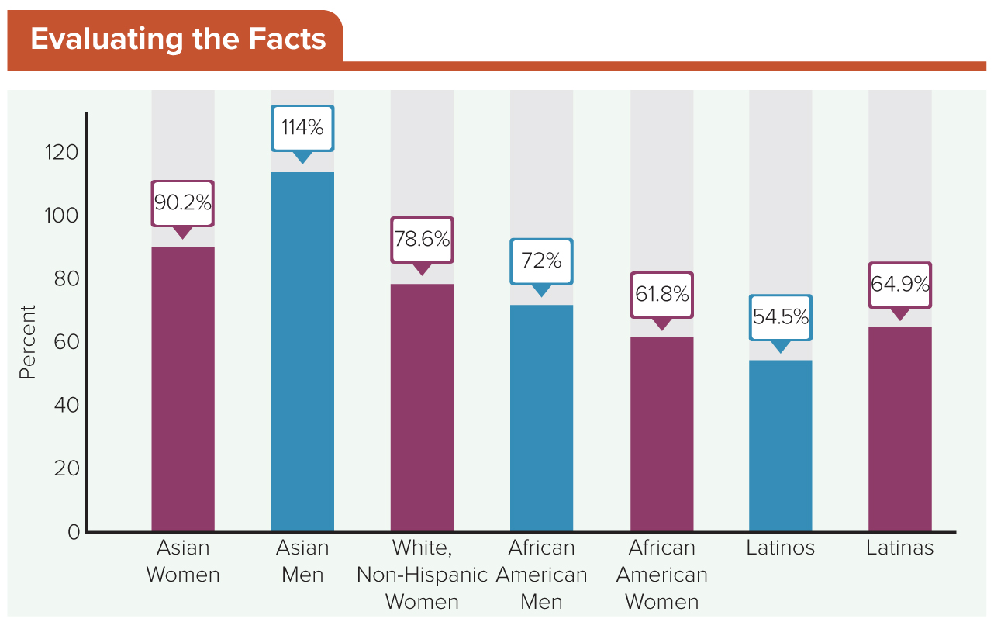
Figure 5.2 The Wage Gap, by Gender and Race
White, non-Hispanic men (not shown on the chart) are at 100 percent, and the bars show the percentage of that amount other demographic groups make.
Access the text alternative for slide images.
SOURCE: U.S. Census Bureau, Current Population Survey. 2019. “PINC-05. Work Experience-People 15 Years Old and Over, by Total Money Earnings, Age, Race, Hispanic Origin, Sex, and Disability Status <https://www.census.gov/data/tables/time-series/demo/income-poverty/cps-pinc/pinc-05.html#par_textimage_0.> (accessed September 10, 2019).

Slide 38
Lesbian, Gay, Bisexual, and Transgendered Citizens (LGBT)
Lesbian, gay, bisexual, and transgender people, and those questioning their sexual identity or who identify as “queer,” are often referred to with the abbreviation LGBTQ+.
Some of the specific rights LGBTQ+ persons have organized to fight for are focused on employment, housing, marriage, and protection from violence.

Slide 39
Rights for Transgender People
Hate crimes are a continuing problem that go largely underreported.
2014 FBI crime data shows violent crime overall is down, but violent crime based on the victim’s sexual identity has increased.
As with other groups, intersectionality complicates the issue.

Slide 40
Growth of the Movement 1
Stonewall Rebellion (1969) and the formation of Lambda Legal (1970).
Protection under the law:
Anti-discrimination laws were introduced by a number of state and local governments in the 1980s.
Sodomy laws in court:
Bowers v. Hardwick (1986) upheld Georgia’s antisodomy law.
Lawrence v. Texas (2003) overturned the Bowers decision.
There is still no federal law prohibiting LGBTQ+-based discrimination in the workplace.

Slide 41
Growth of the Movement 2
Several states have passed legislation affirming the religious liberty of business owners to refuse service to lesbians, gay men, and transgender people.
How do we protect personal religious liberties while simultaneously advancing civil rights?

Slide 42
Same-Sex Marriage
Marriage confers important rights.
Inheritance rights.
Rights to governmental benefits.
Hospital visitation rights.
Decision in United States v. Windsor (2013) declared the 1996 Defense of Marriage Act unconstitutional.
In Obergefell v. Hodges (2015), the Supreme Court found the right to marry was a fundamental liberty and was protected by the due process clause of the Fourteenth Amendment.

Slide 43
Native Americans’ Rights
Until passage of the Indian Citizenship Act of 1924, Native Americans had virtually no rights to U.S. citizenship, and laws that allowed immigrants to become citizens did not apply.
American Indian Movement (AIM), founded in 1968.
Indian Civil Rights Act, 1968.
Indian Gaming Regulatory Act, 1988.
Even with gaming profits, the prospects for many Native Americans today remain bleak.

Slide 44
Citizens of Latin American Descent
U.S. citizens of Latin American descent (Latinos or Latinx) include those whose families hail from Central America, South America, or the Caribbean.
Latinos are the largest minority group in the U.S.
Over 17 percent of the total U.S. population.
Of this Latino population, 67 percent is composed of natural-born U.S. citizens.
Group has lower voter turnout rates that others.

Slide 45
Early Struggles of Mexican Americans
1846, U.S. declared war on Mexico.
1848: Treaty of Guadalupe Hidalgo.
Formation of the League of United Latin American Citizens (LULAC) in 1929.
Mendez v. Westminster (1945) struck down segregated schools in California.

Slide 46
The Chicano Movement
Chicano Movement was composed of Latino organizations focusing on many issues, including equal employment and educational opportunities.
Cesar Chavez was one of the most widely recognized leaders in the movement.
United Farm Workers (UFW) organized successful protests and boycotts to improve working conditions and pay for farmworkers.

Slide 47
Immigration and Other Civil Rights Issues 1
There are approximately 10.5 million undocumented immigrants in the United States.
About 47 percent are Hispanic.
In 2003, U.S. Immigration and Customs Enforcement (ICE) was created to enforce immigration laws.
President Donald Trump in 2017 issued an executive order that expanded the grounds of who could be considered “removable aliens.”
Beginning in July 2019, ICE deported 267,258 individuals.

Slide 48
Immigration and Other Civil Rights Issues 2
Four primary approaches have been discussed nationally to address illegal immigration:
Implementing mass deportations.
Offering pathways to citizenship for families with children born in the United States.
Providing temporary reprieves from deportation without a pathway to citizenship.
Providing refugee status to unaccompanied minors fleeing their home countries.
Issue will continue to be a contentious one.

Slide 49
Citizens of Asian Descent
Asian Americans are from a number of different countries and diverse cultures, religions, histories, and languages.
Like other nonwhite groups, Asian Americans have had to fight continually for their civil rights.
Civil rights groups formed to take up the cause.
Immigration and Nationality Act of 1952.

Slide 50
Internment of Japanese Americans During WWII
Americans of Japanese ancestry were forced to move to government-established camps.
Two-thirds of the 120,000 were native-born U.S. citizens.
Relocated from the West Coast.
Many lost their homes and businesses.
Activists fought for decades to obtain reparations.
In 1987, President Ronald Reagan signed a bill providing $1.2 billion in reparations.

Slide 51
Contemporary Issues for Asian Americans
Immigration waves from Asia in the 1960s and 1980s brought different focuses to their communities.
In the 1960s: civil rights.
In the 1980s: voting rights, hate crimes, and employment discrimination.
Asian Americans have the highest median income compared with the population as a whole, but this varies greatly within Asian origin groups.
Like women, Asian Americans appear to hit a glass ceiling.

Slide 52
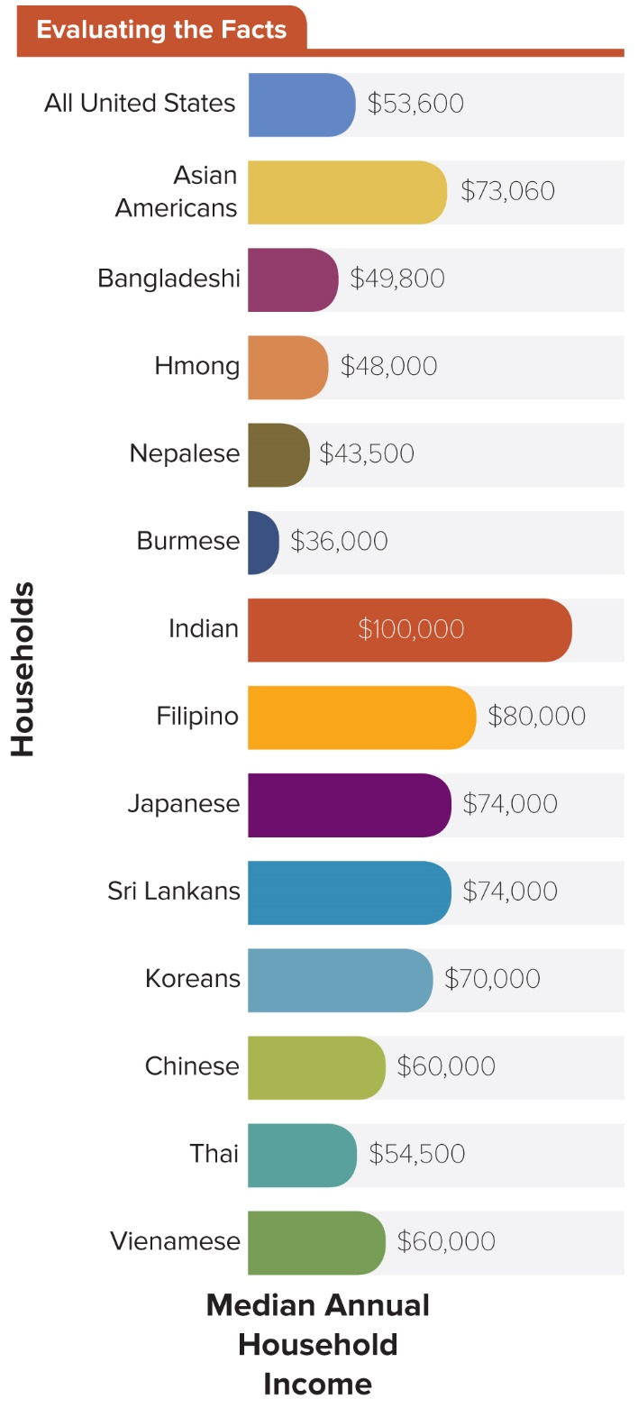
Figure 5.3 Comparative Asian American Household Incomes
This chart shows wide variation in the household incomes of Asian American origin groups.
Access the text alternative for slide images.
SOURCE: Lopez, Gustavo, Neil G. Ruiz and Eileen Patten. Key facts about Asian Americans, a Diverse and Growing Population. Pew Research Center, September 8, 2017.

Slide 53
Citizens with Disabilities
Americans with Disabilities Act (ADA) of 1990.
Defines a disability as any “physical or mental impairment that substantially limits one or more of the major life activities of the individual.”
Americans with Disabilities Act Amendments of 2008.
Act broadens what “substantially limits” and “major life activities” mean.

Slide 54
When Is Voter Suppression a Threat to Civil Rights?
The vote has expanded over time and is no longer limited by race, literacy, and property ownership.
Voter suppression is the attempt to control the outcome of an election by preventing or discouraging voting among certain categories of people.
Those who believe voting is a right view barriers to the ballot for legal voters as suppression.
Those who believe voting is a privilege view access to the ballot as only for the most committed and well informed.

Slide 55
Recent Examples of Voter Suppression
In the 2018 midterm elections there were claims of significant voter suppression in some states.
Names were purged from voter rolls.
Overly strict rules regarding voter IDs were applied.
Polls closed early or there were excessively long wait times.
A 2019 story reported poll workers harassed student voters near Sacred Heart University in Connecticut.
Virginia moved polling places farther from campuses, making access more difficult.

Slide 56
The Question of Voter Fraud
Research into the 2016 and 2018 elections found:
Fraud is very rare.
Voter impersonation is virtually nonexistent.
Mistakes by voters or voting administrators are mischaracterized as fraud.
President Trump established and then later dissolved a Presidential Advisory Commission on Election Integrity before it could issue a final report.

Slide 57
Review 1
Then—African Americans, women, Native Americans, Latinos, and other groups struggled to achieve equality in the United States.
Now—
State-sanctioned attempts to control the voting population are being challenged as civil rights violations.
Changing understandings of gender identity and sexual orientation are altering our definition of civil rights.
Communities of color are protesting abuses from law enforcement through the Black Lives Matter movement.

Slide 58
Review 2
Next—
What protections will the nation be willing to extend to undocumented immigrants and their children?
What will be the impact of new movements such as “Fat Rights” on our understanding of civil rights?
Should quality, affordable housing and child care be considered civil rights?

Slide 59
Questions?

Slide 60
End of Main Content
Copyright 2022 © McGraw Hill LLC. All rights reserved. No reproduction or distribution without the prior written consent of McGraw Hill LLC.

Slide 61
Accessibility Content: Text Alternatives for Images

Slide 62
Figure 5.1 Median Family Wealth by Race/Ethnicity, 1963–2016 – Text Alternative
Return to parent-slide containing images.
Horizontal axis represents year ranging from 1963 to 2016 in increments of 3 from 1989, while vertical axis represents median family wealth ranging from 0 to 200000 dollars in increments of 50000 dollars.
The data is as follows:
White:
Curve begins in 1963 at 50,000 and ends in 2016 at 175,000 passing through the coordinates (1983, 100000), (1989, 140,000), (1992, 115000), (1995, 120000), (1998, 145000), (2001, 160,000), (2004, 175,000), (2007, 200000), (2010, 148000), and (2013, 149000).
Non-White:
Curve begins in 1963 at 0 and ends in 1983 at 12000 showing an increasing trend after 1963.
Black:
Curve begins in 1983 at 12,000 and ends in 2016 at 20,000 passing through the coordinates, (1989, 11000), (1992, 15000), (1995, 14500), (1998, 25000), (2001, 27000), (2004, 26000), (2007, 25000), (2010, 20000), and (2013, 15000).
Hispanic:
Curve begins in 1983 at 11000 and ends in 2016 at 20,500 passing through the coordinates, (1989, 11000), (1992, 14000), (1995, 15000), (1998, 14500), (2001, 14700), (2004, 20000), (2007, 25000), (2010, 20000), and (2013, 15000).
Note: All data is approximate.
Return to parent-slide containing images.

Slide 63
Figure 5.2 The Wage Gap, by Gender and Race – Text Alternative
Return to parent-slide containing images.
A bar graph shows the wage gap by gender and race in comparison to white non-Hispanic men. Asian women 87%, Asian men 117%, white non-Hispanic women 82%, African-American men 73%, African-American women 65%, Latinos 69%, Latinas 58%.
Return to parent-slide containing images.

Slide 64
Figure 5.3 Comparative Asian American Household Incomes – Text Alternative
Return to parent-slide containing images.
Median annual household income:
All United States $53,600.
Asian Americans $73,060.
Bangladeshi $49,800.
Hmong $48,000.
Nepalese $43,500.
Burmese $36,000.
Indian $100,000.
Filipino $80,000.
Japanese $74,000.
Sri Lankan $74,000.
Korean $70,000.
Chinese $60,000.
Thai $54,500.
Vietnamese $60,000.
Return to parent-slide containing images.

